Slide 1
Methods for Handling Deadlocks

Slide 2
Deadlock Prevention
Avoiding the Deadlock
Deadlock detection & Recovery
Deadlock Ignorance (Ostrich Method)

Slide 3
Deadlock Prevention
Deadlock Characteristics As discussed in the previous post, deadlock has following characteristics.
Mutual Exclusion
Hold and Wait
No preemption
Circular wait
Deadlock Prevention We can prevent Deadlock by eliminating any of the above four conditions.

Slide 4
Cont..
Eliminate Mutual Exclusion It is not possible to dis-satisfy the mutual exclusion because some resources, such as the tape drive and printer, are inherently non-shareable.

Slide 5
Eliminate Hold and wait
Allocate all required resources to the process before the start of its execution, this way hold and wait condition is eliminated but it will lead to low device utilization. for example, if a process requires printer at a later time and we have allocated printer before the start of its execution printer will remain blocked till it has completed its execution.

Slide 6
Cont…
The process will make a new request for resources after releasing the current set of resources. This solution may lead to starvation.
Waiting time out

Slide 7

Eliminate No Preemption
Preempt resources from the process when resources required by other high priority processes.
Process holding some resources & requesting for another resource that cant be immediately allocated then all the acquired resources will be prempted
When a process request a resource and its allocated to a waiting process then resource its prempted and given to requested process.

Slide 8
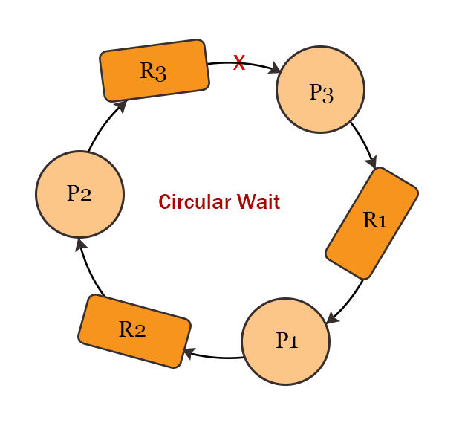
Remove Circular wait
To request resource Rj, a process must first releases all Ri such that i>=j
Determining the relative ordering of different resources is very difficult
This algorithm prevent circulat wait

Slide 9
